Slide 1
Model-Based Conceptual Design and Management
Hiroyasu Ishikawa
82033067

Slide 2
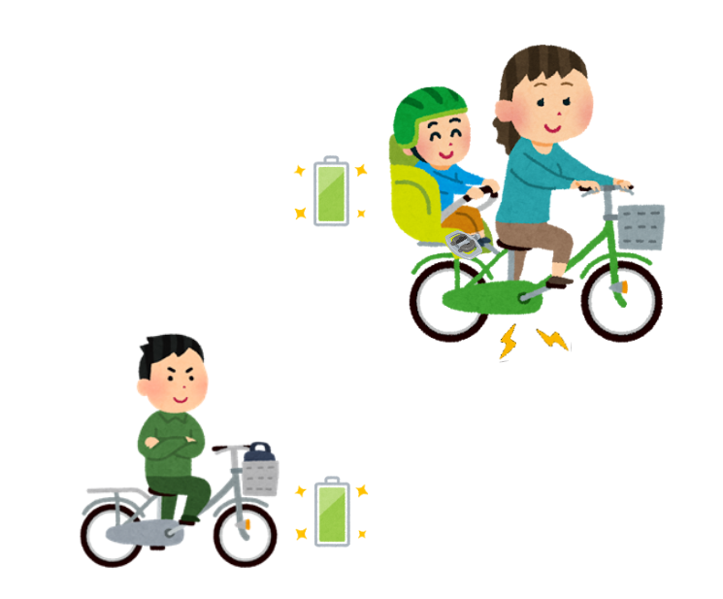
Idea: Shared bicycles that also share energy
Bicycle-sharing system
Child can assist by generating electricity
Dad can also assist by generating electricity (charging)

Slide 3
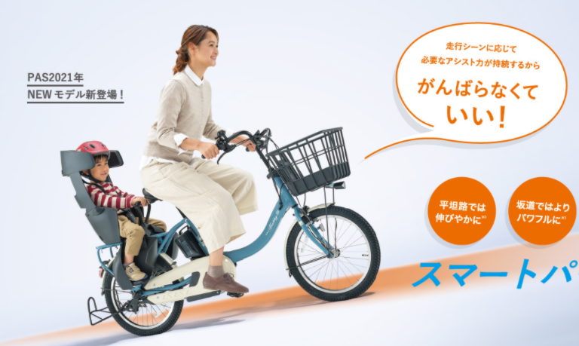
Where the idea from
It is rather hard work.
He’s doing nothing
Daddy is not here.
How can we make it easier for mom by making dad and dad work harder?

Slide 4

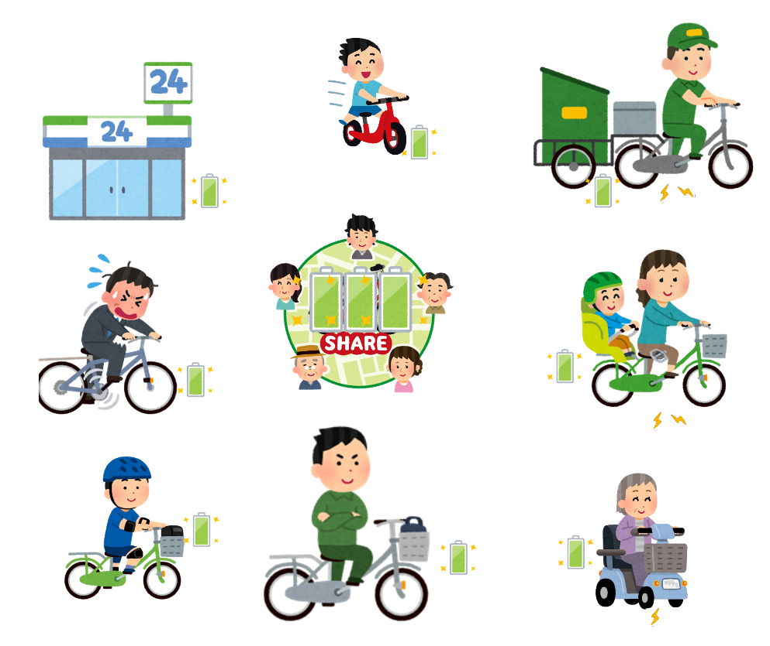

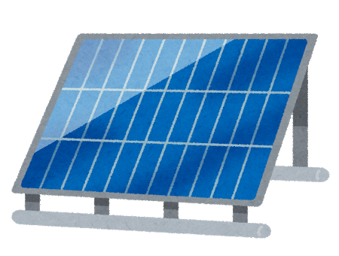
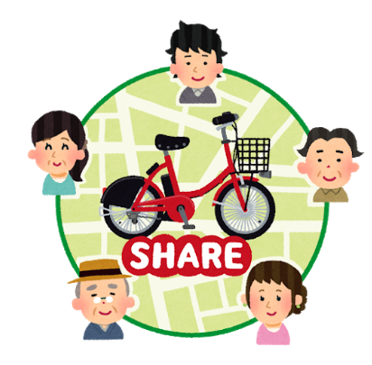
Can we all share the “energy”?
Not only sharing bikes, share energy
みんなでこいで充電したらどうなるか
Dad can assist indirectly, remotely

Slide 5
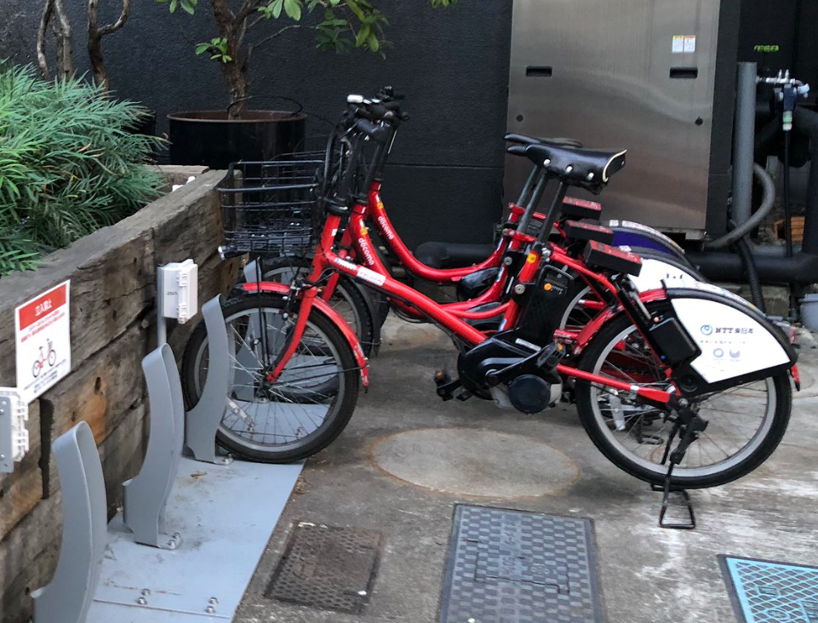
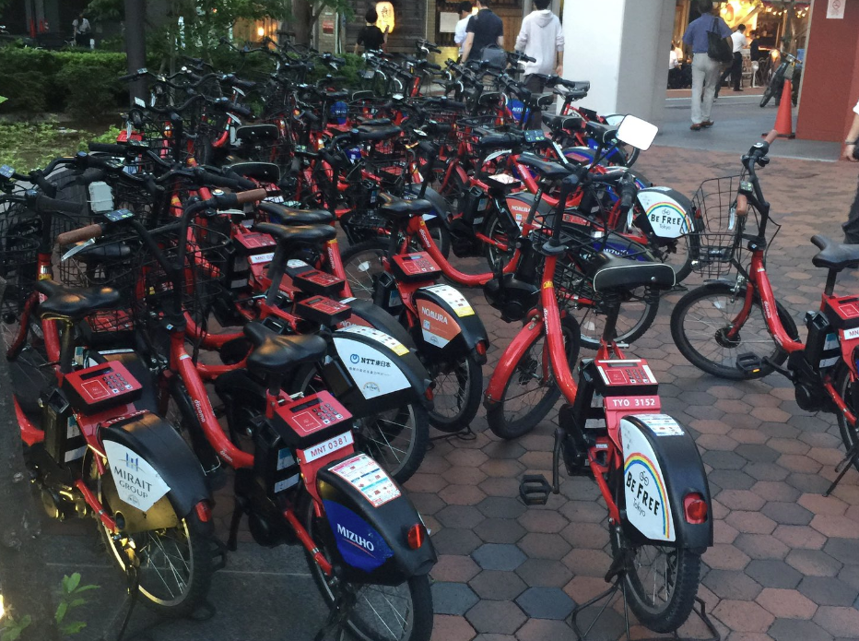
Could also solve the bike station problem
Can be recharged when the number of bikes is small.
Not easy to recharge bikes

Slide 6
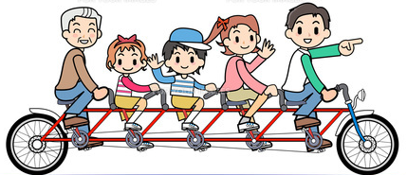
More Fun Mobility for Everyone

